Slide 1
Rounding and estimating
This is for lesson 2-3
EQ:How do we round and estimate and how do we know when to use each?

Slide 2
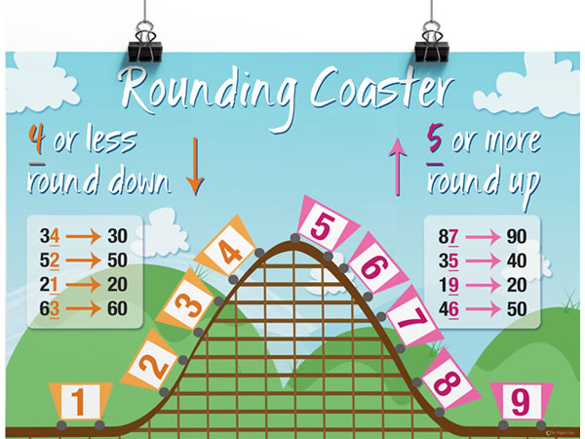
rounding
This is for rounding whole numbers. We do the same thing when we have decimal places too.

Slide 3
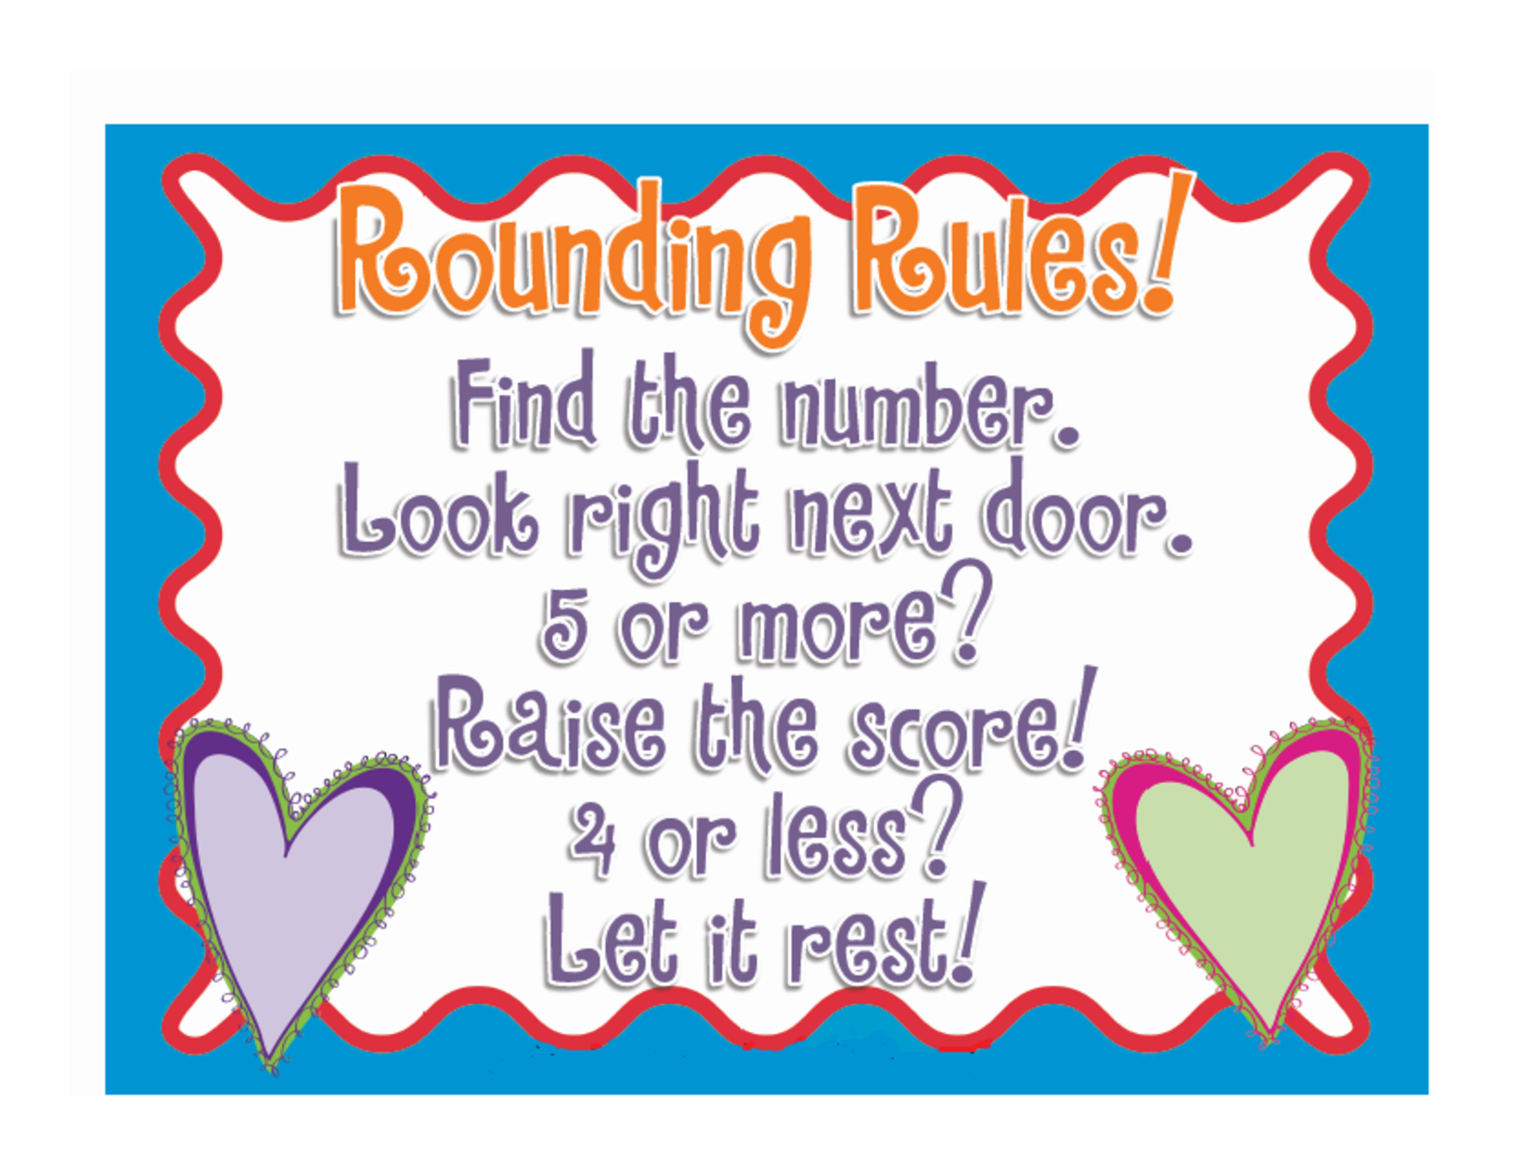

Slide 4

Rounding to a number of decimal places
Round 6.93247 to 4dp
-this means I want exactly 4 decimal places in my answer.
6.93247
6.9325
Is the 7 five or more?
Yes then the 4 will indeed become a 5.

Slide 5
Rounding Practise
Round to 10, 100, 1000 excel spreadsheet
Rounding to decimal places excel spreadsheet
Rounding off decimals worksheet- 2 sides

Slide 6
Money
When we pay in cash we round money to the nearest 5 cents at the end of the transaction.
But if we are paying for items on card we will pay the exact amount.
$3.98 =$4.00 if you are paying cash
Now if I buy 3 items at $3.98
how much will I pay if using cash? Card?

Slide 7
Estimation
How do I use estimation to help my calculations?
Sometimes I don’t need exact answers. I just want an approximate answer?
Estimate 198 x 12
198 is almost 200 and 12 is pretty close to 10
So it is approx. 200x 10.

Slide 8
2_MONEY worksheet

Slide 9
Practice BASKETBALL
Using a variety of questions from the following worksheets, students working in pairs write their answers on mini whiteboards.
They get 20 sec (timed using a timer) to write their answers.
Correct answers- students get to choose if they want to shoot a goal from 1 point mark in classroom or 3 pt or 5 pt. Teacher to keep scoreboard
Worksheets:
2_Money 1 workhseet.pdf
2_Money 2 workhseet.pdf
2_Rounding questions

